Slide 1


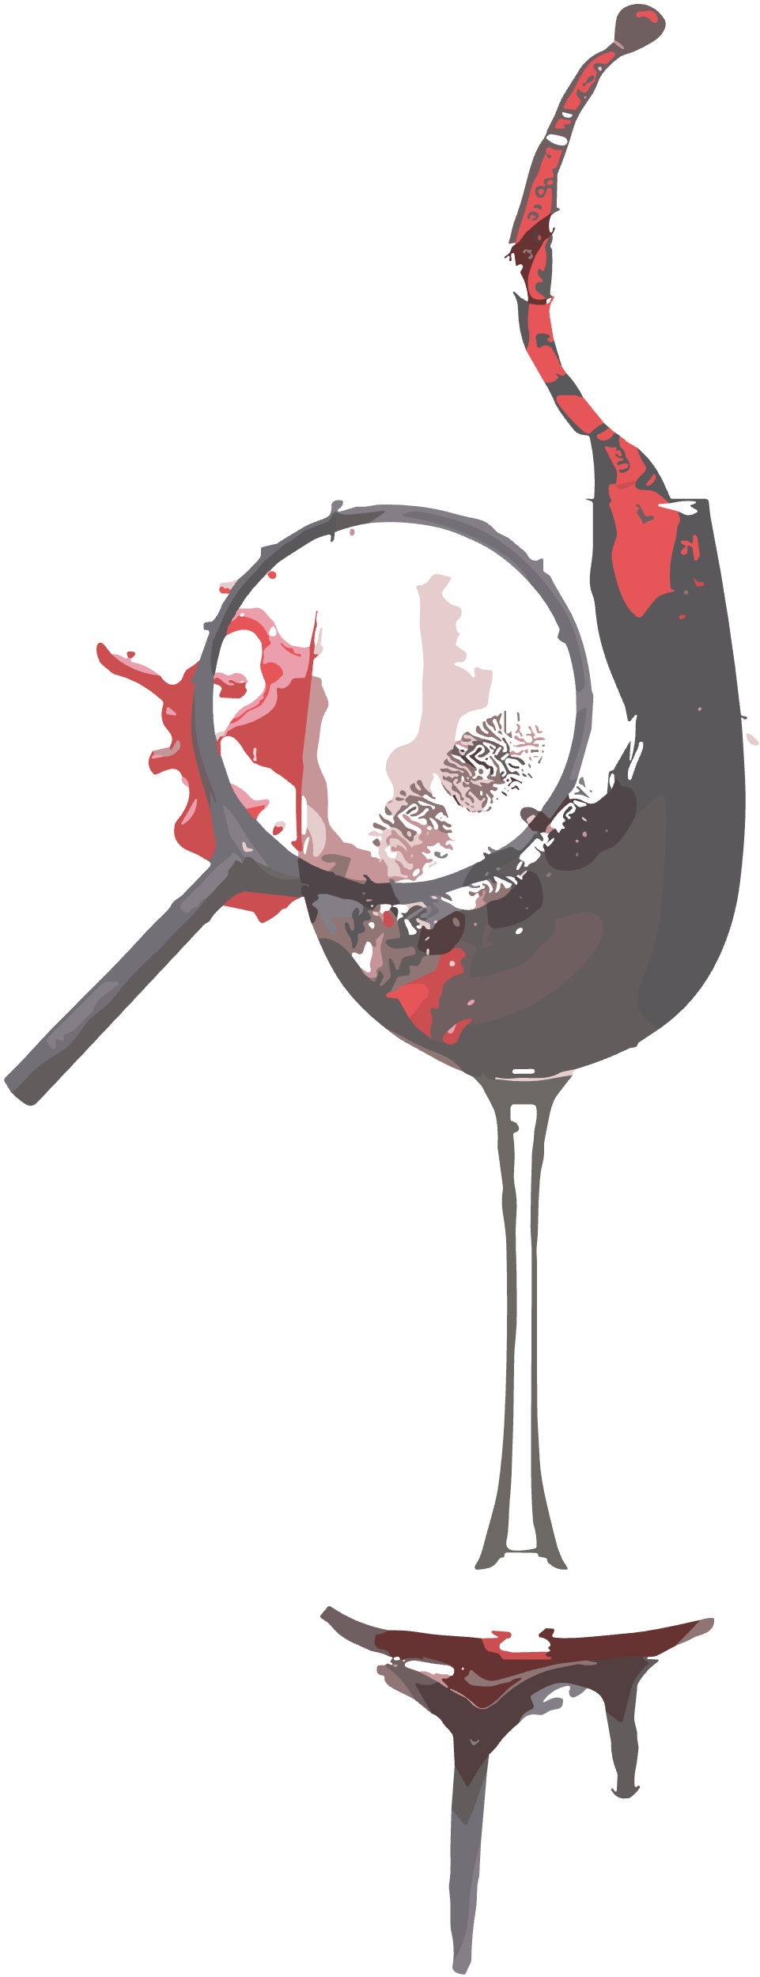
IV CONVEGNO INTER (NATIONAL) GRUPPI SIMLA
Congress of the Forensic Science Scientific Associations of the
Italian Society of Legal Medicine
Modena, 5-7 June 2025

